Slide 1

VANGUARD ONLINE PERFORMANCE
Jedson W Shangi
Created by Jedson Shangi

Slide 2
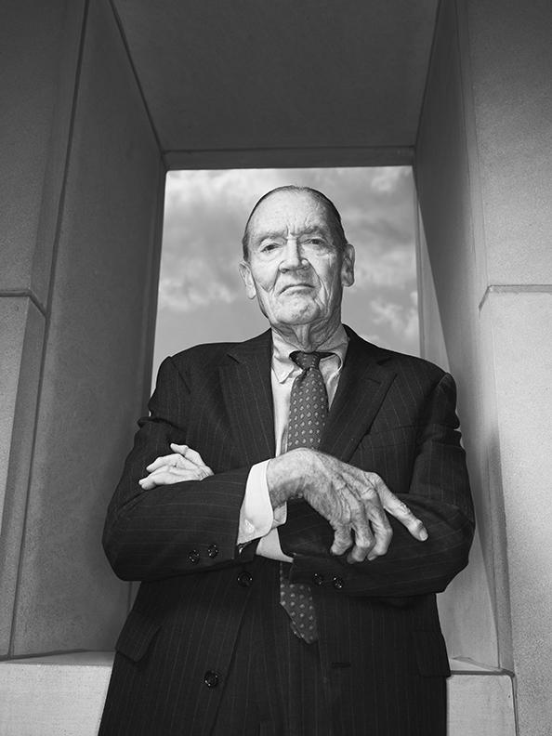
Introduction
Vanguard is an American registered investment advisor based in Malvern, Pennsylvania, with about $7.7 trillion in global assets under management, as of April 2023. It is the largest provider of mutual funds and the second_largest provider of exchange_traded funds in the world after BlackRock’s iShares.
Founder John c. Bogle
Goal
Would the new user interface lead to a higher user completion rate?

Slide 3
Three data sets
Clients Demographic data
Client Foot-prints
Experiment groups
70609 clients

Slide 4
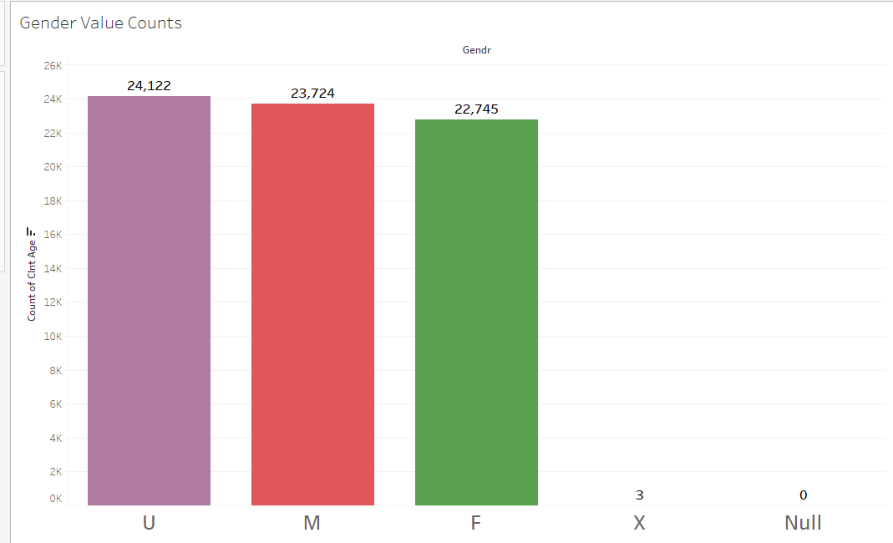
It is clear that the undisclosed gender type is the most active on the new user interface however the difference is not big compared to the the males and females.

Slide 5
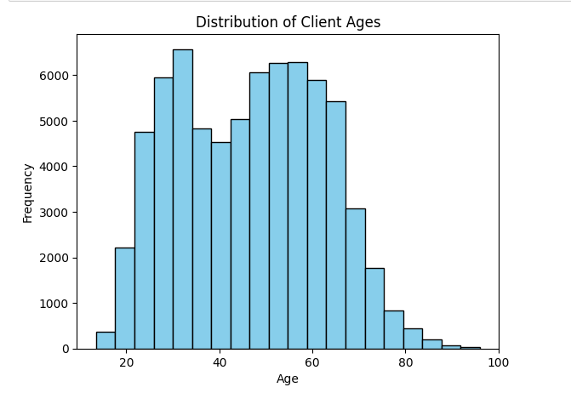
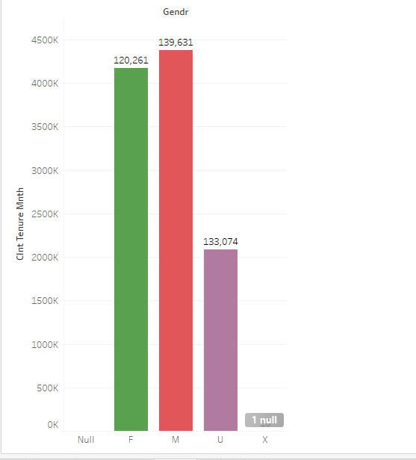
DAA TOVERVIEW

Slide 6
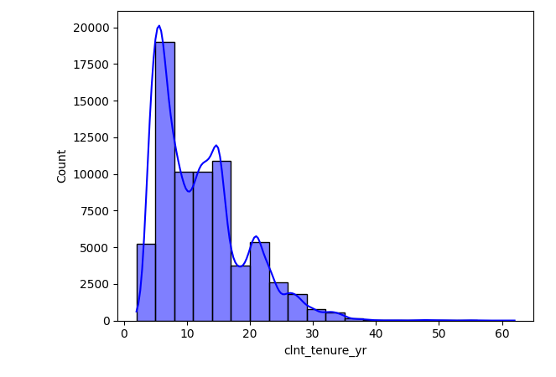

Slide 7
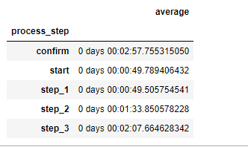
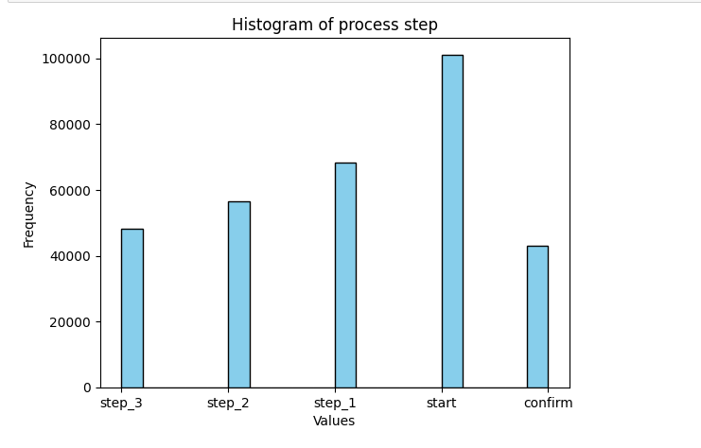
Clients took longer at completing the first step and this could be due to so many factors such as unfamiliarity to the user interface

Slide 8
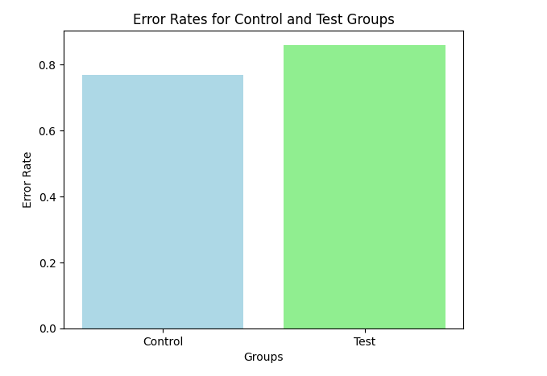
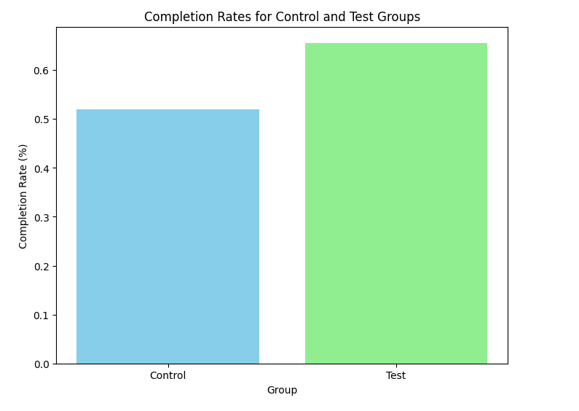
There more error rates in the test group but also more completion rates here.

Slide 9
Challenges
Challenge 1
Challenge 2
Challenge 3
Time Shortage
Limited time to digest all the lessons in a short period of time.
Visualization issues
Starting testing is and visualization is a an issue
Programming Background
Still having to catch up so many topics from the past and this keeps affecting my projects.

Slide 10
Conclusion
The new new user interface was a success and so we should switch to the the new user interface

